Slide 1
File Organization, Record Organization and Storage Access

Slide 2
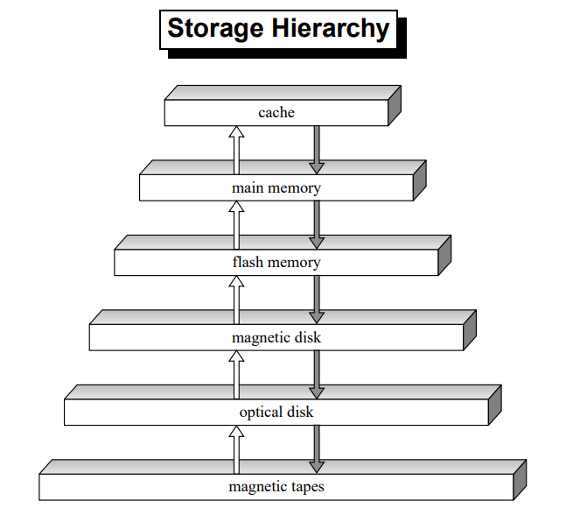

Slide 3
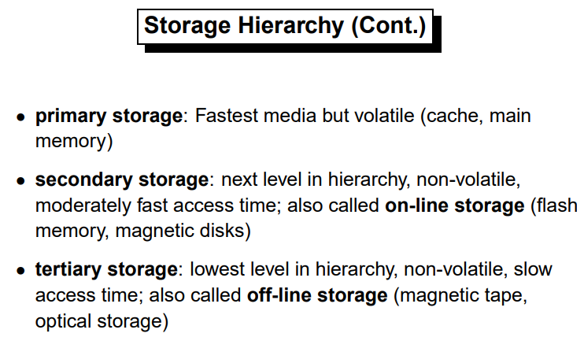

Slide 4
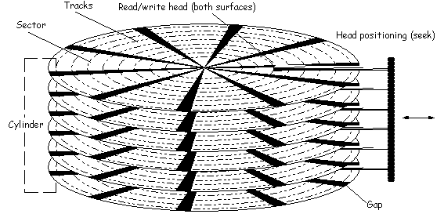
The Hard (Magnetic) disk
4
The time for a disk block access, or disk page access or disk I/O
access time = seek time + rotational delay + transfer time
IBM Deskstar 14GPX: 14.4GB
Seek time: 9.1 msec
Rotational delay: 4.17 msec
Transfer rate: 13MB/sec, that is, 0.3msec/4KB
Notes:
4

Slide 5
Disk vs. SSD
5
While access times of fast hard disks are typically from 5 to 10 milliseconds, solid state drive (SSD) access times are in the 25 to 100 microsecond range.
SSDs are as much as 100 times faster because there is no mechanical seek time or latency associated with flash memory storage (typically uses NAND Flash memory).However, transfer rate is less than disk. Nowadays transfer rate of Flash emory is comparable with disks.
Channel speed (transfer rate) and caching contribute to overall storage performance.

Slide 6
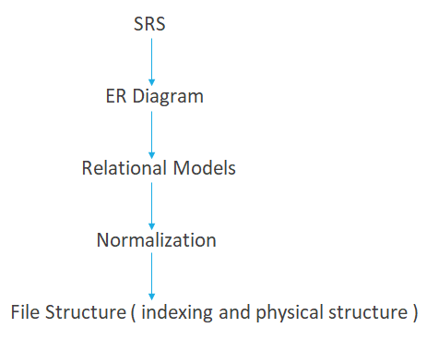
File Structure

Slide 7
File Organization
The database is stored as a collection of files. Each file is a sequence of records. A record is a sequence of fields.
One approach:
assume record size is fixed
each file has records of one particular type only
different files are used for different relations
This case is easiest to implement; will consider variable length records later.
File is a set of records and set is an unordered structure
Contiguous Allocation
Linked Allocation
Indexed Allocation

Slide 8
Sorted file | Unsorted File
Can be sorted only according to one attribute (search key) | Random order, any record can be placed any where
Searching will fast | Searching will be slow
Insertion deletion will be difficult | Insertion deletion will be easy

Slide 9
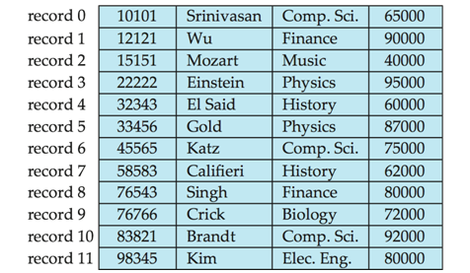
Fixed-Length Records
Simple approach:
– Store record i starting from byte n (i − 1), where n is the
size of each record.
– Record access is simple but records may cross blocks.
Modification: do not allow records to cross block boundaries

Slide 10
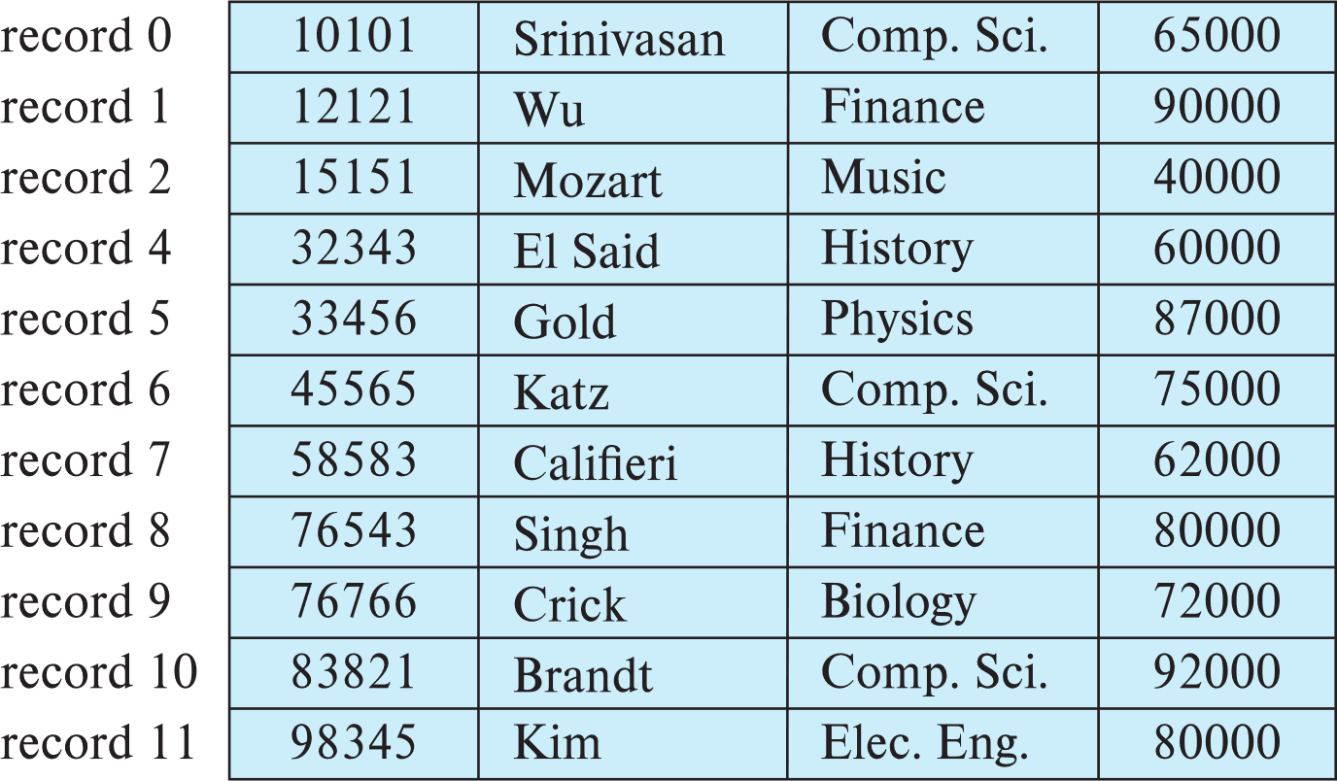
Fixed-Length Records
Deletion of record i: alternatives:
move records i + 1, . . ., n to i, . . . , n – 1
move record n to i
do not move records, but link all free records on a free list
Record 3 deleted

Slide 11
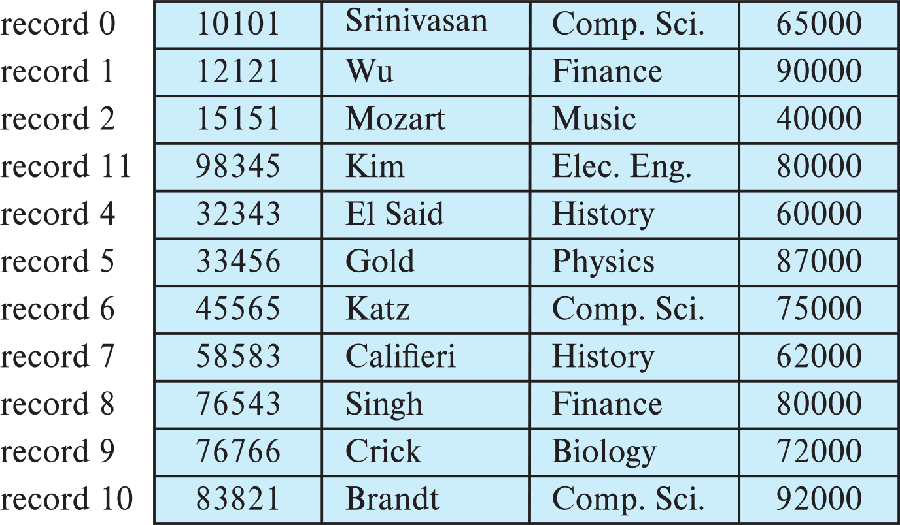
Fixed-Length Records
Deletion of record i: alternatives:
move records i + 1, . . ., n to i, . . . , n – 1
move record n to i
do not move records, but link all free records on a free list
Record 3 deleted and replaced by record 11

Slide 12
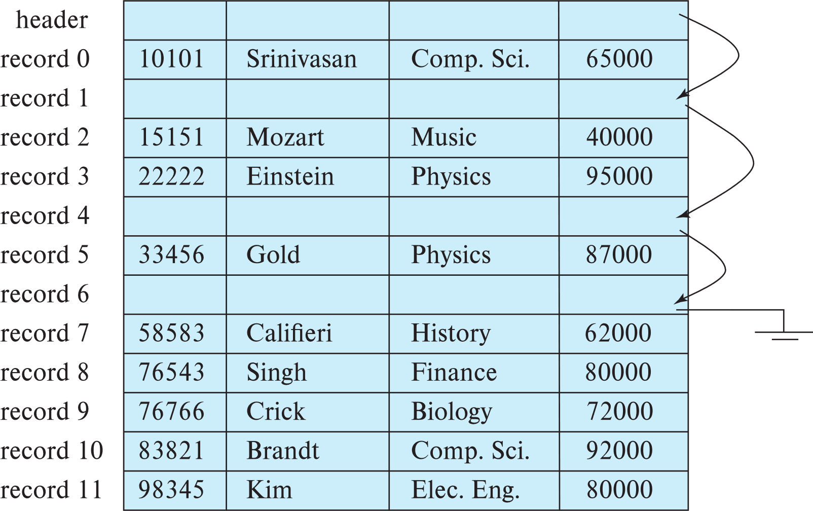
Fixed-Length Records
Deletion of record i: alternatives:
move records i + 1, . . ., n to i, . . . , n – 1
move record n to i
do not move records, but link all free records on a free list

Slide 13
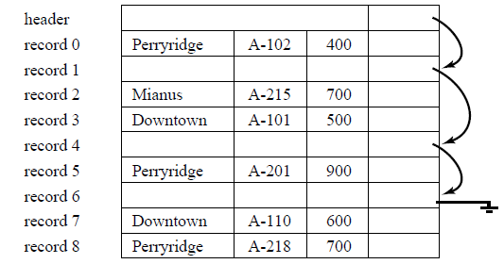
Free Lists
Store the address of the first record whose contents are deleted in the file header.
Use this first record to store the address of the second available record, and so on
Can think of these stored addresses as pointers since they “point” to the location of a record.

Slide 14
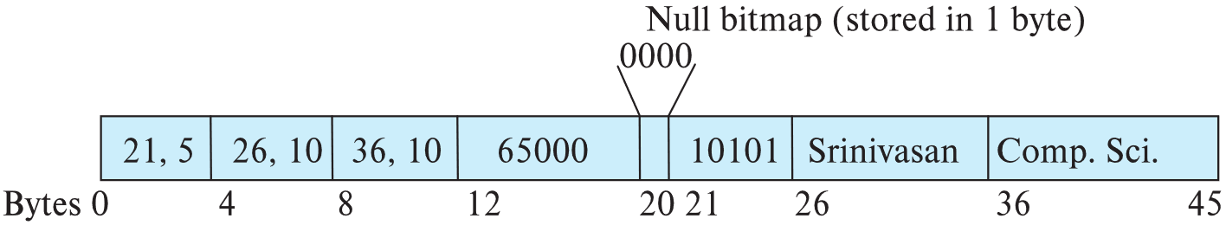
Variable-Length Records
Variable-length records arise in database systems in several ways:
Storage of multiple record types in a file.
Record types that allow variable lengths for one or more fields such as strings (varchar)
Record types that allow repeating fields (used in some older data models).
Attributes are stored in order
Variable length attributes represented by fixed size (offset, length), with actual data stored after all fixed length attributes
Null values represented by null-value bitmap. If any bit is 1 I bit map then that filed is empty , having no value. This is done to save storage at the cost of extra work to extract attributes. Used for sparse tables having less values.

Slide 15
Variable-Length Records: Slotted Page Structure( inside a memory block)
Slotted page header contains:
number of record entries
end of free space in the block
location and size of each record
Records can be moved around within a page to keep them contiguous with no empty space between them; entry in the header must be updated.
Pointers should not point directly to record — instead they should point to the entry for the record in header.

Slide 16
Organization of Records in Files
Heap – a record can be placed anywhere in the file where there is space
Sequential – store records in sequential order, based on the value of the search key of each record
Hashing – a hash function computed on some attribute of each record; the result specifies in which block of the file the record should be placed
Records of each relation may be stored in a separate file. In a multitable clustering file organization records of several different relations can be stored in the same file
Motivation: store related records on the same block to minimize I/O

Slide 17
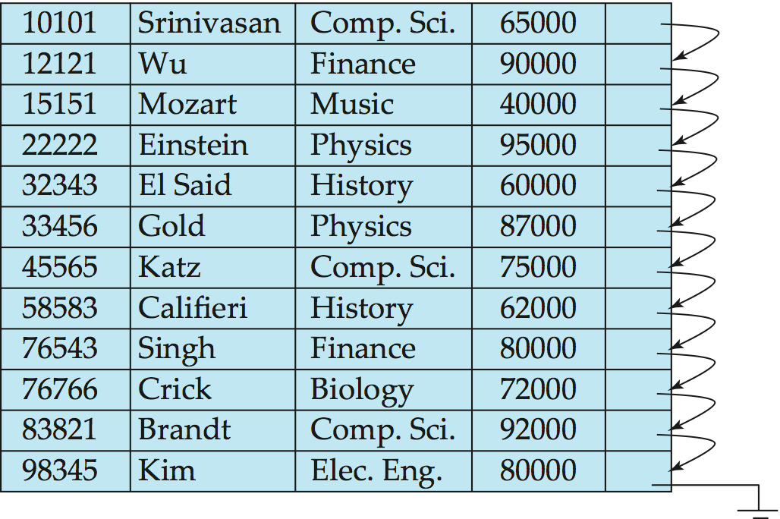
Sequential File Organization
Suitable for applications that require sequential processing of the entire file
The records in the file are ordered by a search-key

Slide 18
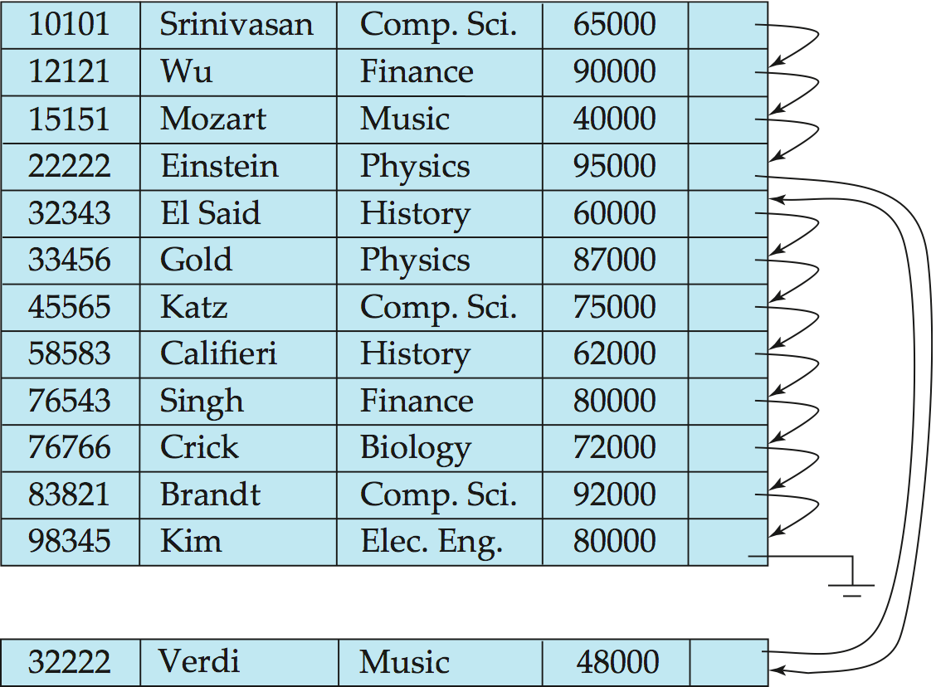
Sequential File Organization (Cont.)
Deletion – use pointer chains
Insertion –locate the position where the record is to be inserted
if there is free space insert there
if no free space, insert the record in an overflow block
In either case, pointer chain must be updated
Need to reorganize the file from time to time to restore sequential order

Slide 19
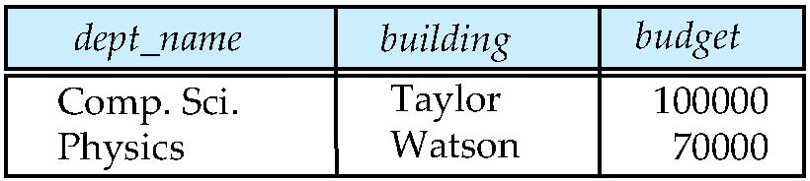
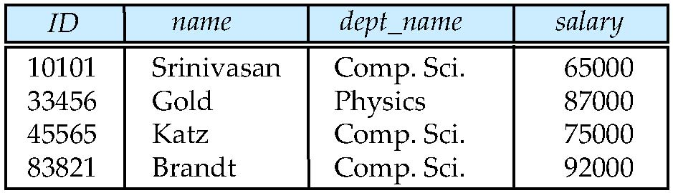
Multitable Clustering File Organization
Consider query
Select dept_name, buliding, budget, ID, name, salary from department natural join instructor
In this query, for each tuple of department, the system must locate the instructor tuple with some value for dept_name.
For such kind of queries multi table clustering organization is better instead of different file for each relation

Slide 20
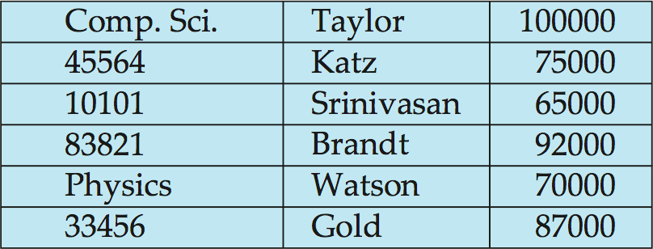
Multitable Clustering File Organization
Store several relations in one file using a multitable clustering file organization
department
instructor
multitable clustering
of department and
instructor

Slide 21
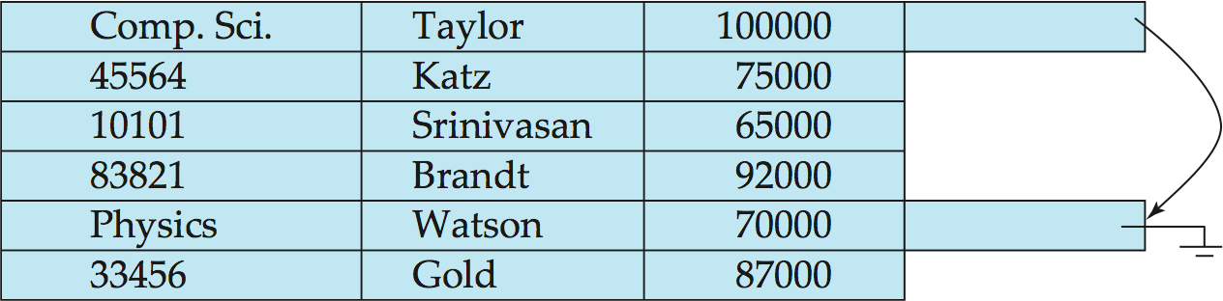
Multitable Clustering File Organization
good for queries involving department natural join instructor, and for queries involving one single department and its instructors
bad for queries involving only department such as select * from department
results in variable size records
Can add pointer chains to link records of a particular relation

Slide 22
Data Dictionary Storage
The Data dictionary (also called system catalog) stores metadata; that is, data about data, such as
Information about relations
names of relations
names, types and lengths of attributes of each relation
names and definitions of views
integrity constraints
User and accounting information, including passwords
Statistical and descriptive data
number of tuples in each relation
Physical file organization information
How relation is stored (sequential/hash/…)
Physical location of relation
Information about indexes
Some data systems store such meta data by using some special purpose data structures and code. However, it is preferable to store data about database as relations in database it self. However, exact choice of representation is made by database designers.

Slide 23
Relational Representation of System Metadata
Relational representation on disk
Specialized data structures designed for efficient access, in memory

Slide 24
Storage Access
A database file is partitioned into fixed-length storage units
called blocks. Blocks are units of both storage allocation and
data transfer.
Database system seeks to minimize the number of block
transfers between the disk and memory. We can reduce the
number of disk accesses by keeping as many blocks as
possible in main memory.
Buffer – portion of main memory available to store copies of
disk blocks.
Buffer manager – subsystem responsible for allocating buffer space in main memory.

Slide 25
Buffer Manager
Programs call on the buffer manager when they need a block from disk.
If the block is already in the buffer, buffer manager returns the address of the block in main memory
If the block is not in the buffer, the buffer manager
Allocates space in the buffer for the block
Replacing (throwing out) some other block, if required, to make space for the new block.
Replaced block written back to disk only if it was modified since the most recent time that it was written to/fetched from the disk.
Reads the block from the disk to the buffer, and returns the address of the block in main memory to requester.
Notes:
25

Slide 26
Buffer Manager
Buffer replacement strategy
Pinned block: memory block that is not allowed to be written back to disk
Pin done before reading/writing data from a block
Unpin done when read /write is complete
Multiple concurrent pin/unpin operations possible
Keep a pin count, buffer block can be evicted only if pin count = 0
Shared and exclusive locks on buffer
Needed to prevent concurrent operations from reading page contents as they are moved/reorganized, and to ensure only one move/reorganize at a time
Readers get shared lock, updates to a block require exclusive lock
Locking rules:
Only one process can get exclusive lock at a time
Shared lock cannot be concurrently with exclusive lock
Multiple processes may be given shared lock concurrently

Slide 27
Buffer-Replacement Policies
Most operating systems replace the block least recently used (LRU strategy)
Idea behind LRU – use past pattern of block references as a predictor of future references
LRU can be bad for some queries
Queries have well-defined access patterns (such as sequential scans), and a database system can use the information in a user’s query to predict future references
Mixed strategy with hints on replacement strategy provided by the query optimizer is preferable
Example of bad access pattern for LRU: when computing the join of 2 relations r and s by a nested loops
for each tuple tr of r do for each tuple ts of s do if the tuples tr and ts match …
Notes:
27

Slide 28
Buffer-Replacement Policies (Cont.)
Toss-immediate strategy – frees the space occupied by a block as soon as the final tuple of that block has been processed
Most recently used (MRU) strategy – system must pin the block currently being processed. After the final tuple of that block has been processed, the block is unpinned, and it becomes the most recently used block.
Buffer manager can use statistical information regarding the probability that a request will reference a particular relation
E.g., the data dictionary is frequently accessed. Heuristic: keep data-dictionary blocks in main memory buffer
Operating system or buffer manager may reorder writes
Can lead to corruption of data structures on disk
E.g., linked list of blocks with missing block on disk
File systems perform consistency check to detect such situations
Careful ordering of writes can avoid many such problems
Notes:
28

